Slide 1
GRADE 7 ACCELERATED · UNIT 3 · LESSON 5
Applying Exponent Laws
MA.8.NSO.1.3
I can rewrite a rational base with a negative exponent using a positive exponent, and apply several laws to generate an equivalent expression.
Yesterday: a negative exponent means reciprocal.
Today the base is a fraction — so the reciprocal flips it.
Grade 7 Accelerated · Unit 3 · Lesson 5 — Applying Exponent Laws
1

Slide 2

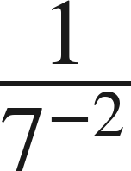


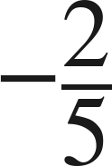
Warm-Up
On your own. Four minutes. No notes.
1. Find the value:
2. Rewrite with a positive exponent:
3. Which is larger,
or
?
4. Write the reciprocal of
Grade 7 Accelerated · Unit 3 · Lesson 5 — Applying Exponent Laws
2

Slide 3



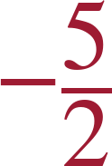
Warm-Up
Answers.
1. Find the value:
2. Rewrite with a positive exponent:
3. Which is larger,
or
?
(81 > 64)
4. Write the reciprocal of
Grade 7 Accelerated · Unit 3 · Lesson 5 — Applying Exponent Laws
3

Slide 4
Notes
Copy the table.
I. The pattern with a fraction base
Expression | Expanded | Value
(2/5)² | 2/5 · 2/5 | 4/25
(2/5)¹ | 2/5 | 2/5
(2/5)⁰ | 1 | 1
(2/5)⁻¹ | 5/2 | 5/2
(2/5)⁻² | 5/2 · 5/2 | 25/4
Grade 7 Accelerated · Unit 3 · Lesson 5 — Applying Exponent Laws
4

Slide 5
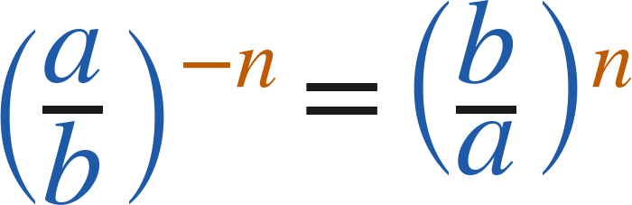
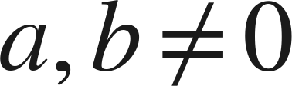
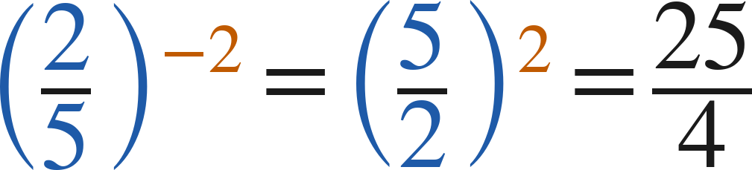
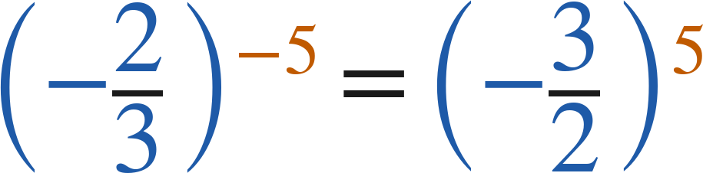
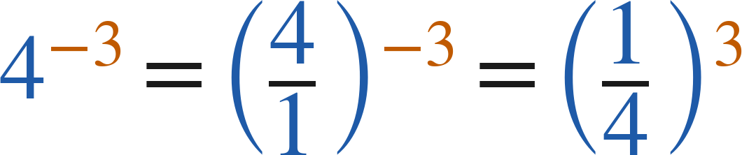
Notes
II. Flip the base, make the exponent positive
(
)
The sign stays with the fraction. Flip the numbers, not the sign.
A whole number is a fraction over 1:
Grade 7 Accelerated · Unit 3 · Lesson 5 — Applying Exponent Laws
5

Slide 6
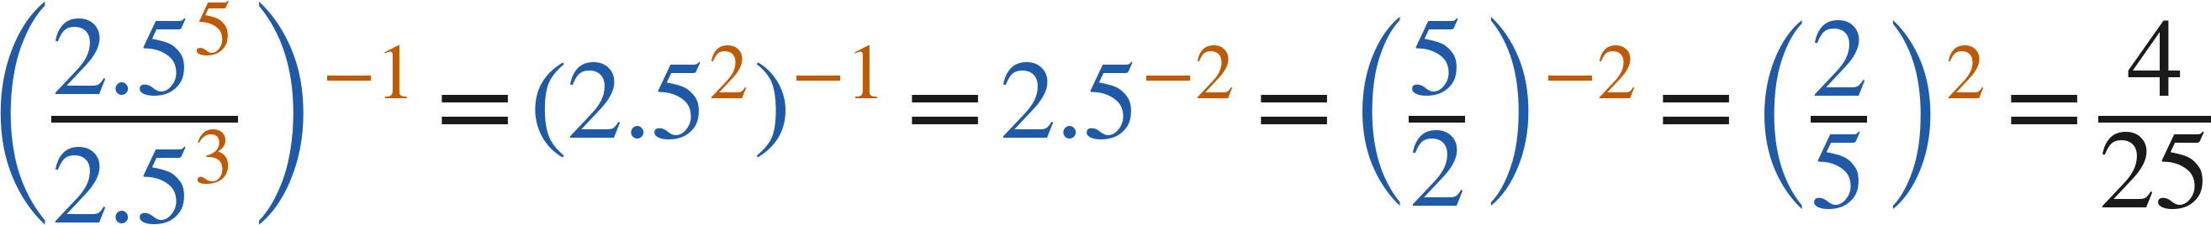
Notes
III. Several laws at once — the plan is still yours
Any correct order of laws gives the same value. Finish with a positive exponent.
Grade 7 Accelerated · Unit 3 · Lesson 5 — Applying Exponent Laws
6

Slide 7
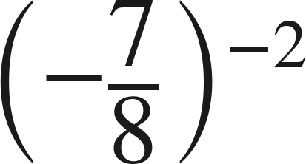
Example 1
Flip, then evaluate.
Rewrite with a positive exponent, then find the value.
Grade 7 Accelerated · Unit 3 · Lesson 5 — Applying Exponent Laws
7

Slide 8
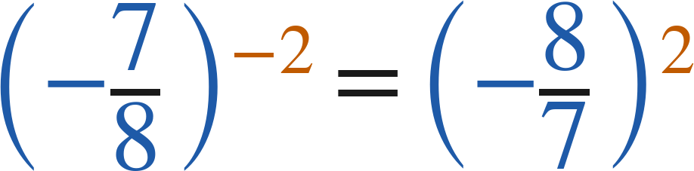
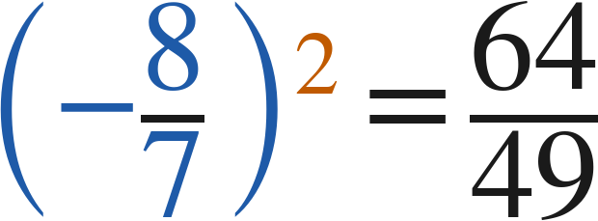
Example 1
Worked.
flip the base; the sign stays
even power: positive
Answer: 64/49
Grade 7 Accelerated · Unit 3 · Lesson 5 — Applying Exponent Laws
8

Slide 9
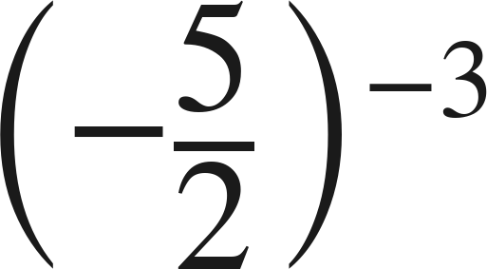
Your Turn
Same steps, your numbers. Boards up when done.
Grade 7 Accelerated · Unit 3 · Lesson 5 — Applying Exponent Laws
9

Slide 10
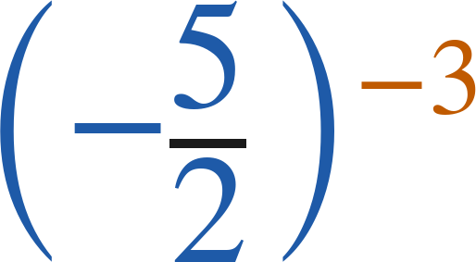
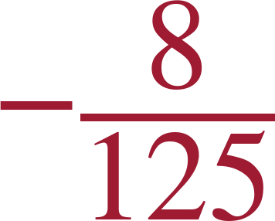
Your Turn
Answer.
(−2/5)³ — odd power, negative
Answer:
Grade 7 Accelerated · Unit 3 · Lesson 5 — Applying Exponent Laws
10

Slide 11
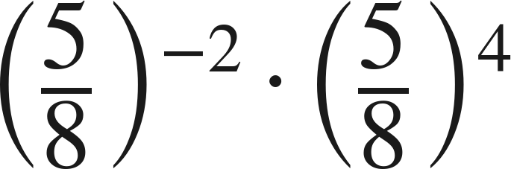
Example 2
Two laws, then a flip.
Write an equivalent expression with one base and a positive exponent.
Grade 7 Accelerated · Unit 3 · Lesson 5 — Applying Exponent Laws
11

Slide 12
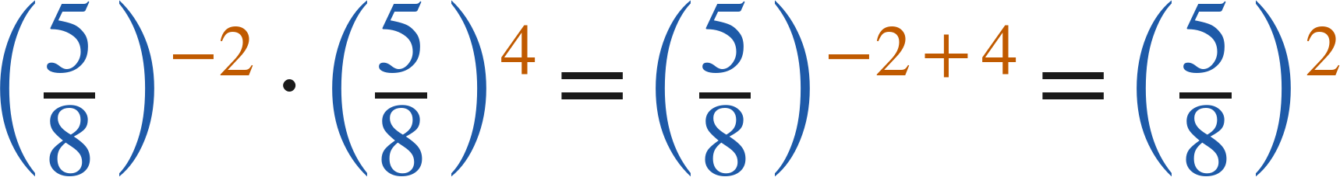
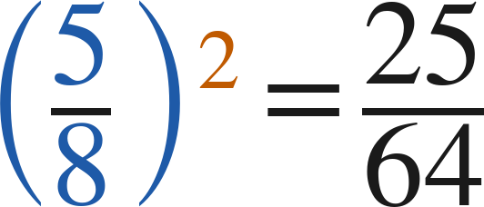
Example 2
Worked.
product of powers
already positive: no flip
Answer: (5/8)² = 25/64
Grade 7 Accelerated · Unit 3 · Lesson 5 — Applying Exponent Laws
12

Slide 13
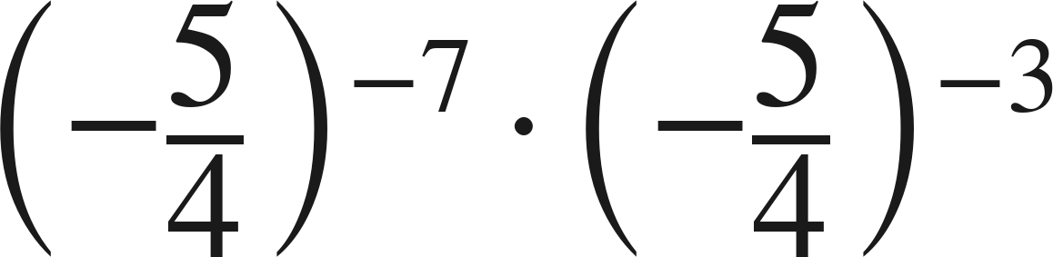
Your Turn
Same steps, your numbers. Boards up when done.
Grade 7 Accelerated · Unit 3 · Lesson 5 — Applying Exponent Laws
13

Slide 14
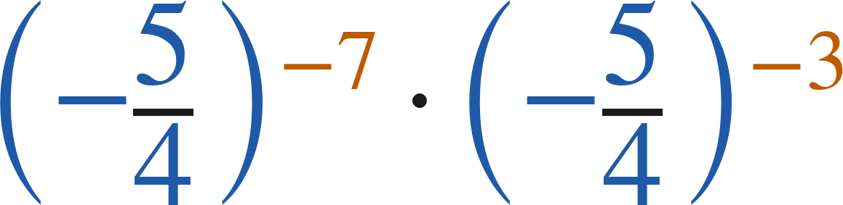
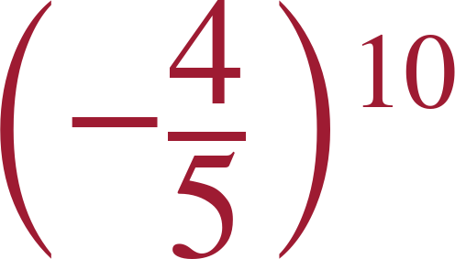
Your Turn
Answer.
exponent −10, then flip: (−4/5)¹⁰
Answer:
Grade 7 Accelerated · Unit 3 · Lesson 5 — Applying Exponent Laws
14

Slide 15
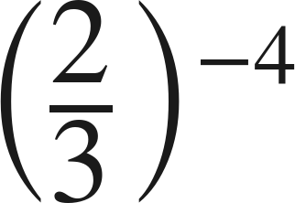
Whiteboards · Question 1 of 9
Boards up on three.
A recipe is scaled by a factor of
.
The original recipe serves 6 people.
Rewrite the factor with a positive exponent.
Answer it.
Rewrite with a positive exponent.
Grade 7 Accelerated · Unit 3 · Lesson 5 — Applying Exponent Laws
15

Slide 16
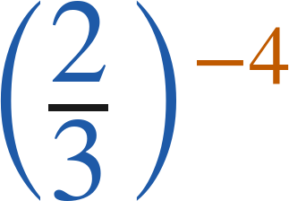
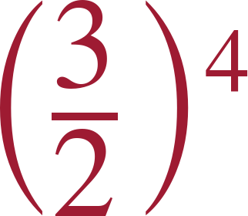
Whiteboards · Question 1 of 9
Answer.
A recipe is scaled by a factor of
.
The original recipe serves 6 people.
Rewrite the factor with a positive exponent.
flip the base
Answer:
Grade 7 Accelerated · Unit 3 · Lesson 5 — Applying Exponent Laws
16

Slide 17
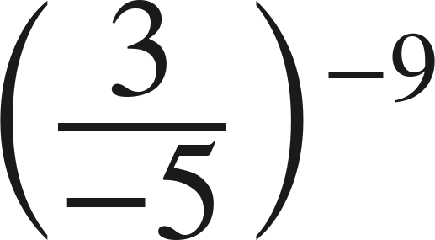
Whiteboards · Question 2 of 9
Boards up on three.
Answer it.
Rewrite with a positive exponent.
Grade 7 Accelerated · Unit 3 · Lesson 5 — Applying Exponent Laws
17

Slide 18
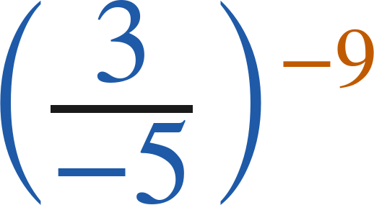
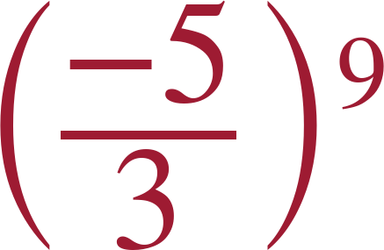
Whiteboards · Question 2 of 9
Answer.
flip the numbers; the sign stays in the fraction
Answer:
Grade 7 Accelerated · Unit 3 · Lesson 5 — Applying Exponent Laws
18

Slide 19
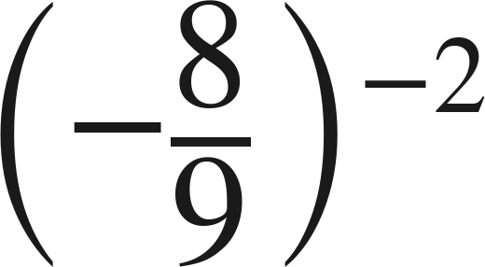
Whiteboards · Question 3 of 9
Boards up on three.
Answer it.
Find the value.
Grade 7 Accelerated · Unit 3 · Lesson 5 — Applying Exponent Laws
19

Slide 20
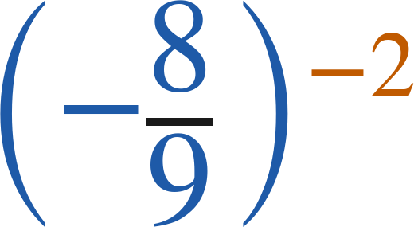

Whiteboards · Question 3 of 9
Answer.
(−9/8)² = 81/64
Answer:
Grade 7 Accelerated · Unit 3 · Lesson 5 — Applying Exponent Laws
20

Slide 21
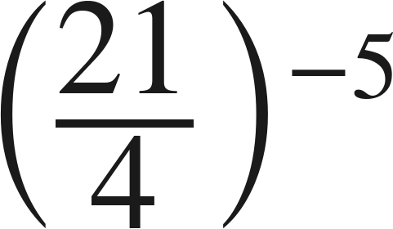
Whiteboards · Question 4 of 9
Boards up on three.
Answer it.
Rewrite with a positive exponent.
Grade 7 Accelerated · Unit 3 · Lesson 5 — Applying Exponent Laws
21

Slide 22
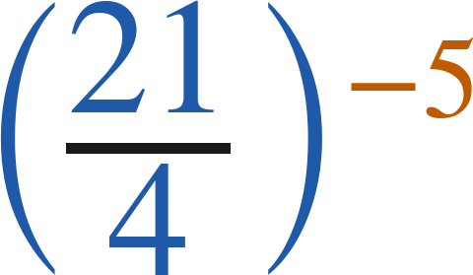
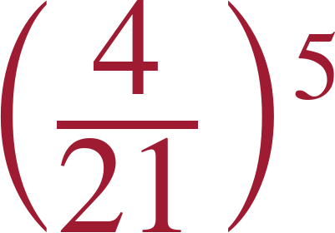
Whiteboards · Question 4 of 9
Answer.
flip
Answer:
Grade 7 Accelerated · Unit 3 · Lesson 5 — Applying Exponent Laws
22

Slide 23
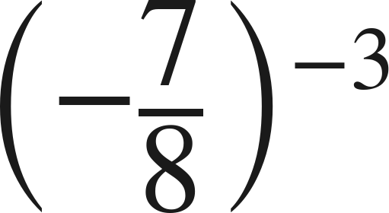
Whiteboards · Question 5 of 9
Boards up on three.
Which expression is equivalent?
A. (−8/7)³
B. (8/7)³
C. (−7/8)³
D. (7/8)³
Answer it.
Grade 7 Accelerated · Unit 3 · Lesson 5 — Applying Exponent Laws
23

Slide 24
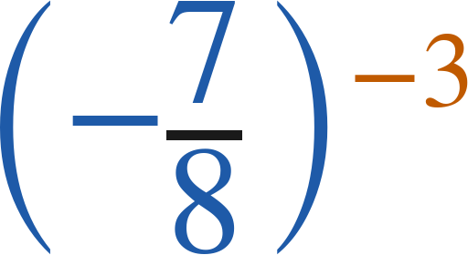
Whiteboards · Question 5 of 9
Answer.
Which expression is equivalent?
A. (−8/7)³
B. (8/7)³
C. (−7/8)³
D. (7/8)³
Answer: A — (−8/7)³
Grade 7 Accelerated · Unit 3 · Lesson 5 — Applying Exponent Laws
24

Slide 25
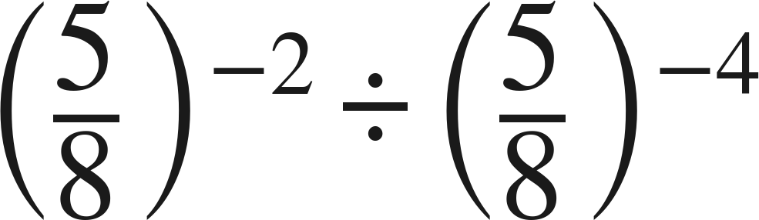
Whiteboards · Question 6 of 9
Boards up on three.
Which expression is equivalent?
A. (5/8)²
B. (8/5)²
C. (5/8)⁻⁶
D. (5/8)⁸
Answer it.
Grade 7 Accelerated · Unit 3 · Lesson 5 — Applying Exponent Laws
25

Slide 26
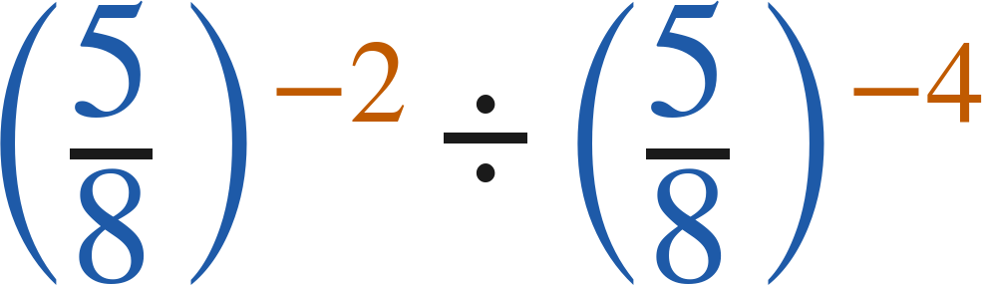
Whiteboards · Question 6 of 9
Answer.
Which expression is equivalent?
A. (5/8)²
B. (8/5)²
C. (5/8)⁻⁶
D. (5/8)⁸
Answer: A — (5/8)²
Grade 7 Accelerated · Unit 3 · Lesson 5 — Applying Exponent Laws
26

Slide 27
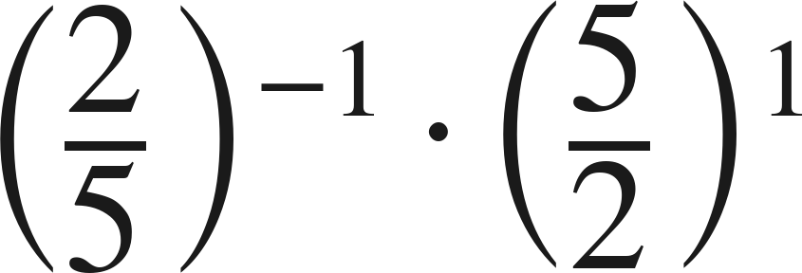
Whiteboards · Question 7 of 9
Boards up on three.
Answer it.
Find the value.
Grade 7 Accelerated · Unit 3 · Lesson 5 — Applying Exponent Laws
27

Slide 28
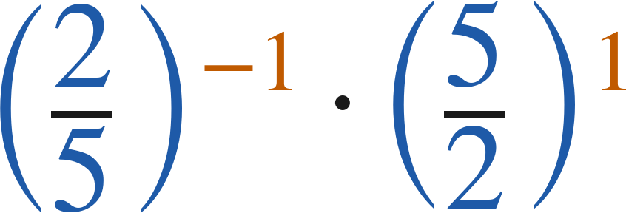
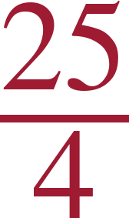
Whiteboards · Question 7 of 9
Answer.
(5/2)¹ · (5/2)¹ = (5/2)²
Answer:
Grade 7 Accelerated · Unit 3 · Lesson 5 — Applying Exponent Laws
28

Slide 29
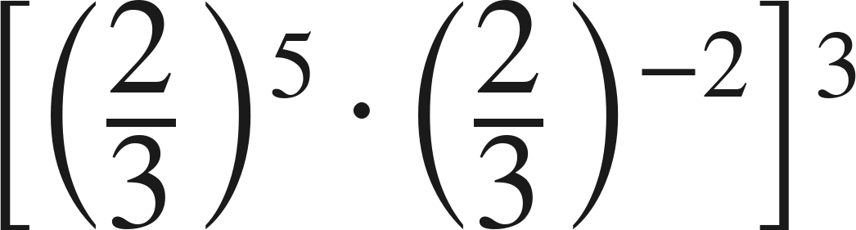
Whiteboards · Question 8 of 9
Boards up on three.
Answer it.
Write it with one base and one positive exponent.
Grade 7 Accelerated · Unit 3 · Lesson 5 — Applying Exponent Laws
29

Slide 30
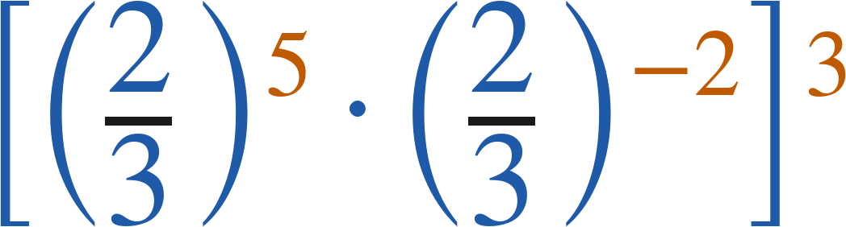
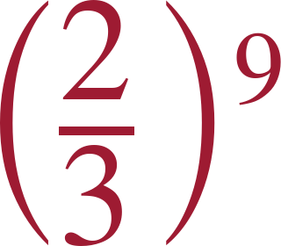
Whiteboards · Question 8 of 9
Answer.
(2/3)³ inside, then power of a power
Answer:
Grade 7 Accelerated · Unit 3 · Lesson 5 — Applying Exponent Laws
30

Slide 31
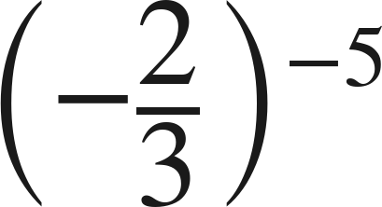
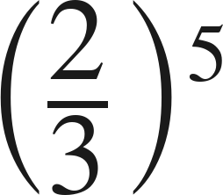
Whiteboards · Question 9 of 9
Take your time. Boards up when you have written it.
Marco says
can be rewritten as
because 'two negatives make a positive.' Is he right?
Write your answer in sentences.
Say what the negative exponent does, and what it does not do. Give the correct rewrite.
Grade 7 Accelerated · Unit 3 · Lesson 5 — Applying Exponent Laws
31

Slide 32
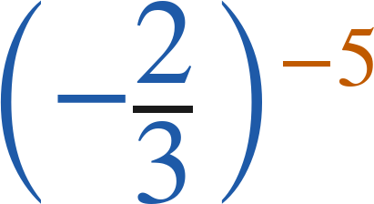
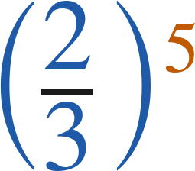
Whiteboards · Question 9 of 9
Answer.
Marco says
can be rewritten as
because 'two negatives make a positive.' Is he right?
the exponent flips the fraction; it never touches the sign
Answer: No — (−2/3)⁻⁵ = (−3/2)⁵
Grade 7 Accelerated · Unit 3 · Lesson 5 — Applying Exponent Laws
32

Slide 33
Independent Set
Six questions. On your own, in silence.
1.
Six questions. Work down the page.
2.
Show the step that does the work, not just the answer.
3.
Silence until the six minutes are up.
Grade 7 Accelerated · Unit 3 · Lesson 5 — Applying Exponent Laws
33

Slide 34
IXL
Last five minutes.
1.
Open IXL and start today's skills.
2.
Work on paper where the question needs work. The answer box does not show it.
3.
Every skill listed is required, to a SmartScore of 67. Due at the start of the next class.
Today's skills — all required
Identify equivalent expressions involving exponents I — VLM
Grade 7 Accelerated · Unit 3 · Lesson 5 — Applying Exponent Laws
34

